Slide 1

Carbon Credit Coin CCGA

Slide 2

About Us
Voluntary Carbon Markets
The VCM is a decentralized market where private actors voluntarily buy and sell carbon credits that represent certified removals or reductions of greenhouse gases (GHGs) in the atmosphere.
We are social enterprise developing solution for companies to achieve net-neutral target by offering voluntary carbon credit token on Ethereum blockchain

Slide 3
Agenda
Regulartory Framework
Solution
Implementation
Output-Based Pricing System
Development of VCM
Technical Implementation & Demo

Slide 4
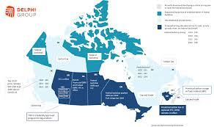
Canada Regulatory Framework

Slide 5





The Regulation
OBPS
Tax
Credit
Regulation
State Impact
Output-Based Pricing System (OBPS), a regulatory trading system for emission-intensive, trade exposed industries in backstop jurisdictions.
Paying the carbon price to the government via an excess emissions charge;
Remitting compliance units that may either be surplus credits, federal offset credits (see section 3.1.6), or recognized units.
OBPS Regulations and that emit 50kt or more of CO2e per year.
250 facilities registered under the OBPS, which includes 121 mandatory covered facilities and 129 opt-in facilities
DEC 2020

Slide 6
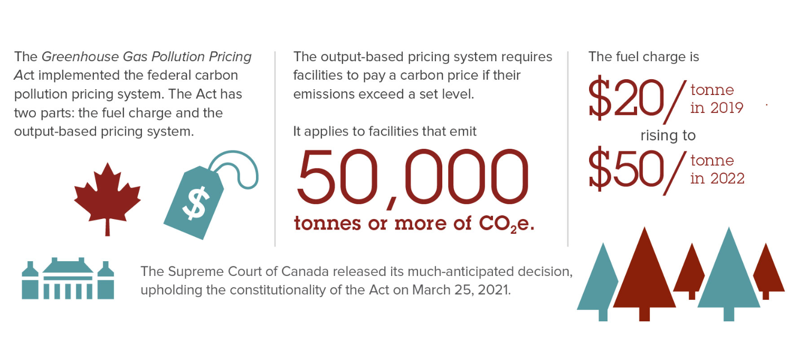
OBPS Pricing
3.1.4. Surplus credits
In accordance with GGPPA and the OBPS Regulations, the Minister of the Environment will issue surplus credits, in the department’s on-line Credit and Tracking System (CATS) to persons responsible for covered facilities whose GHG emissions are lower than their facility’s emissions limit for a given compliance period. The persons responsible can sell their surplus credits or bank them for future use or sale.

Slide 7
CCGA – Blockchain based VCM

Slide 8

Business Case
Demand is starting to outstrip supply for highest quality voluntary carbon credits this is expected to further tighten over the next 2-3 years.
As the demand grows, It is also broadening from companies in Europe and North America to emerging marketing.
The largest companies are the largest buyer of carbon markets.
Digital led innovation using block chain to tokenize carbon credits aims to broaden the market.

Slide 9
Market Opportunity
Opportunity to Build 30 Million market
As of 2022, 1000 Companies and 137 Countries made commitment to be Net neutral
AUM of 137 Countries
$30M
1.5
$437t

Slide 10



Business Model
There is an opportunity for success
Who is using the system
Global Demand
Opportunities
There are only 250 companies registered in OBPS system has a opportunity to expand
Global Banks project that demand for Nature based Projects.
5bn – 30bn (2030)
1tr(2050)
Tokenized Trading Platform
Climate Asset Management
Financial Advisory
Venture Capital

Slide 11


Tokenization of Carbon Credit
How does tokenization work?
To put credits on the blockchain, crypto firms first "retire" them on the Verra system or on other carbon credit registries like Gold Standard and the American Carbon Registry or OBPS.
This is a way of showing that the emissions reductions represented by each credit (one tonne of CO2) have been counted towards a corporate or individual's goal - essentially, used up.
Based on this, crypto companies then issue a digital token worth one carbon credit, which can be traded on crypto exchanges or "burned" by the buyer to offset their emissions.

Slide 12

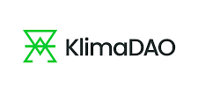

Competition
Convenience
Expensive
Affordable
Marred by Supply side Carbon Credit Quality.
The Thomson Reuters Foundation found that one major pioneer in this new market, Brazilian "green" crypto firm Moss, bought carbon credits it said privately were of "low quality" - a judgment it later reversed in response to the investigation - and mixed them with others to back its digital token, selling them on for far more than it paid.
Inconvenient

Slide 13
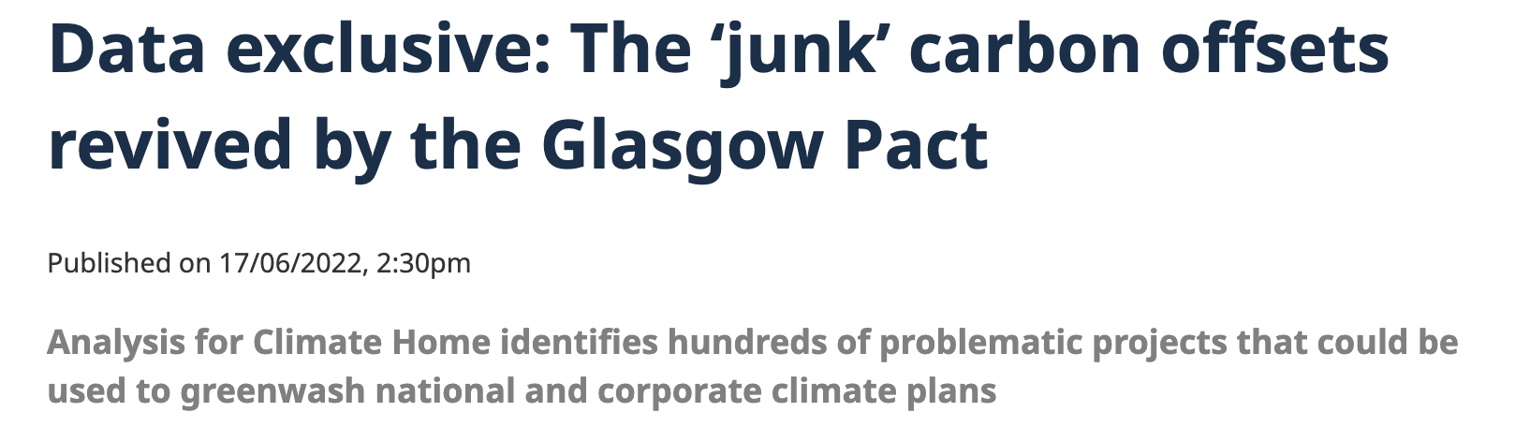
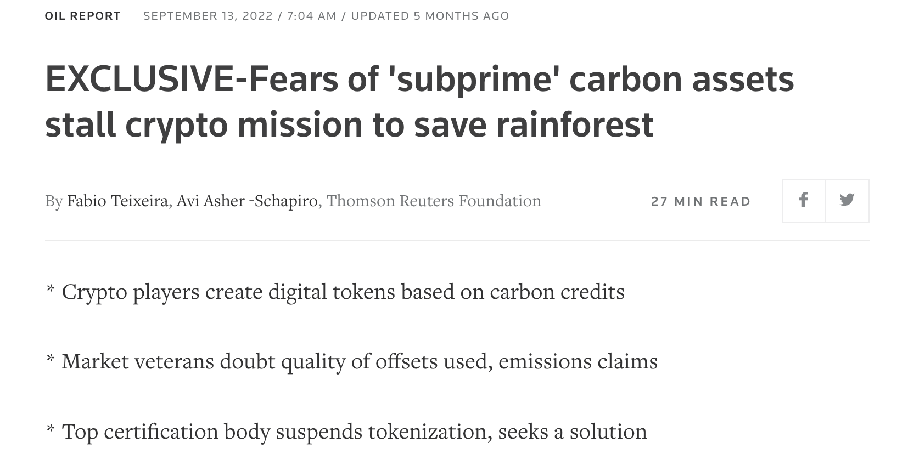
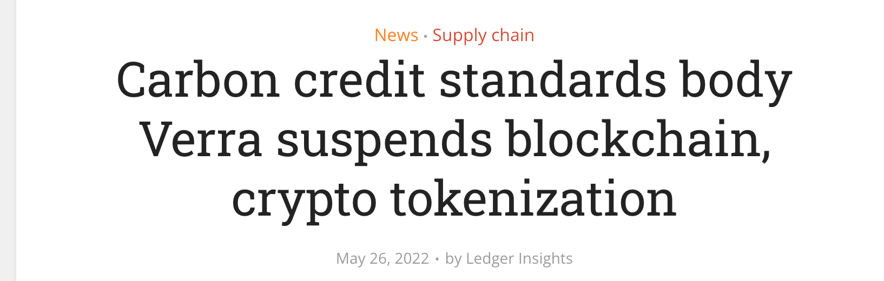
Problems with Industry

Slide 14


The Solution
Seller
Unifier
Buyer
The companies which have Carbon Credit to sell
Carbon Credit Management Company
Buyer of Carbon Credit Token and get the details of Carbon Credit source for OBPS submission, Veera or American Carbon Registry

Slide 15
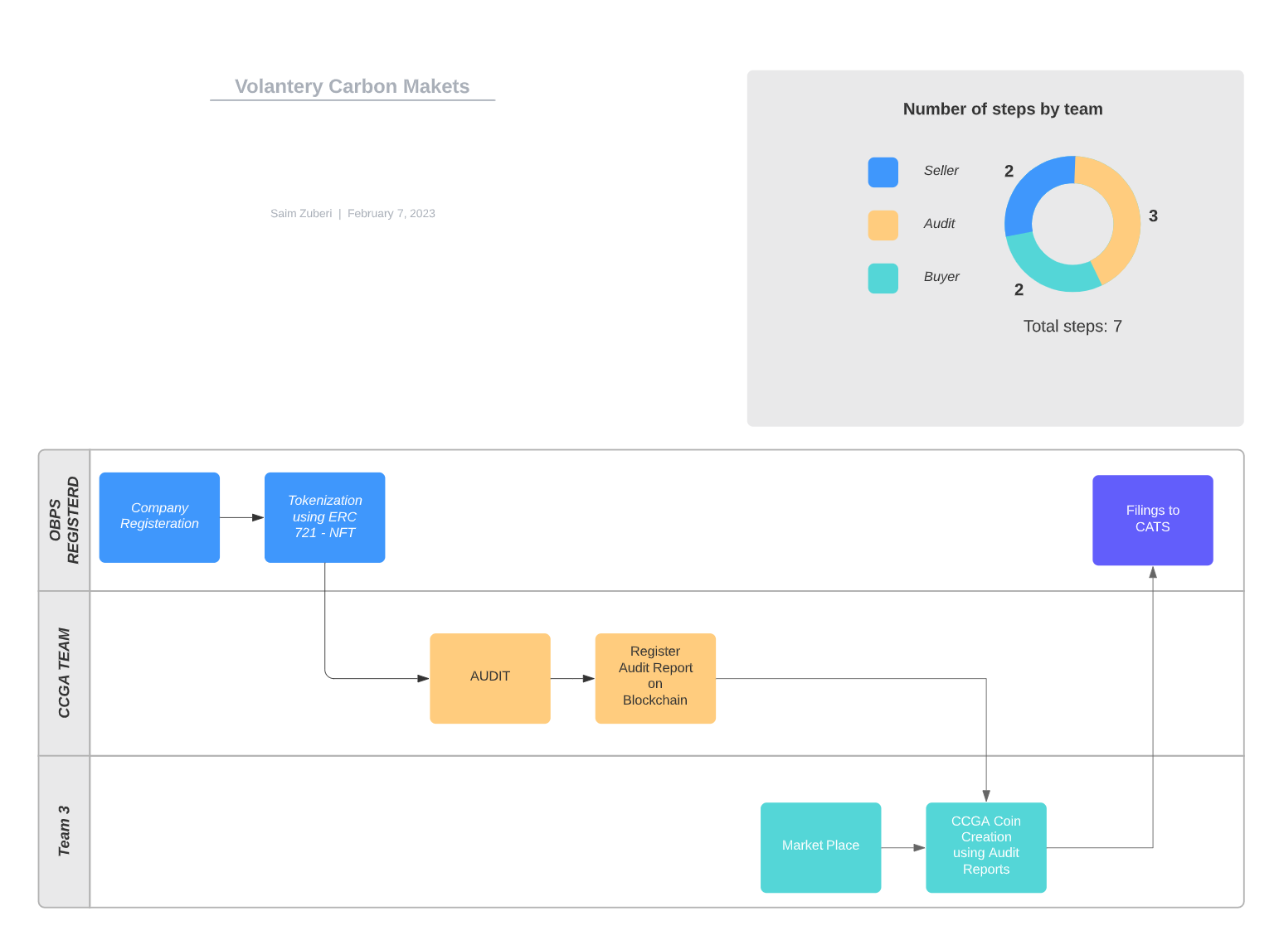
Process Flow

Slide 16




The Product
Web Links
Registration Link
Audit Link
Market Place
Block Chain
ERC 721 – Company Registration
ERC 721 – Token Logs
ERC20 – Tokenization of Carbon Credits
Payment System
Ethereum Payment System

Slide 17
Technology Stack
Python
Solidity
Ganache
Pinata
Polygon
Meta Mask

Slide 18
Demonstration

Slide 19






Thank You
Saim Zuberi
+1 437 995 8750
saim@xyper.io
www.xyper.io

